Slide 1
Space Minute
2022 August
Notes:
This is the first “monthly space minute” presentation. And for this month the topic is “Record Setting Number of people in space”
How many?

Slide 2
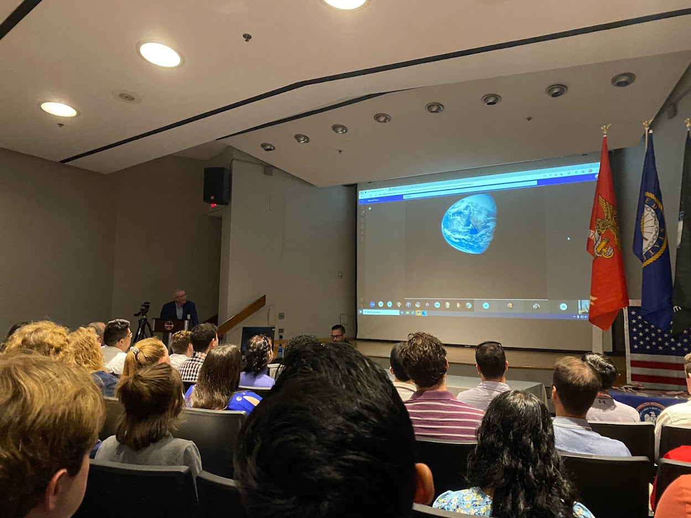
Fred Haise, Apollo 13 Astronaut
Johnson Space Center
August 1, 2022

Slide 3
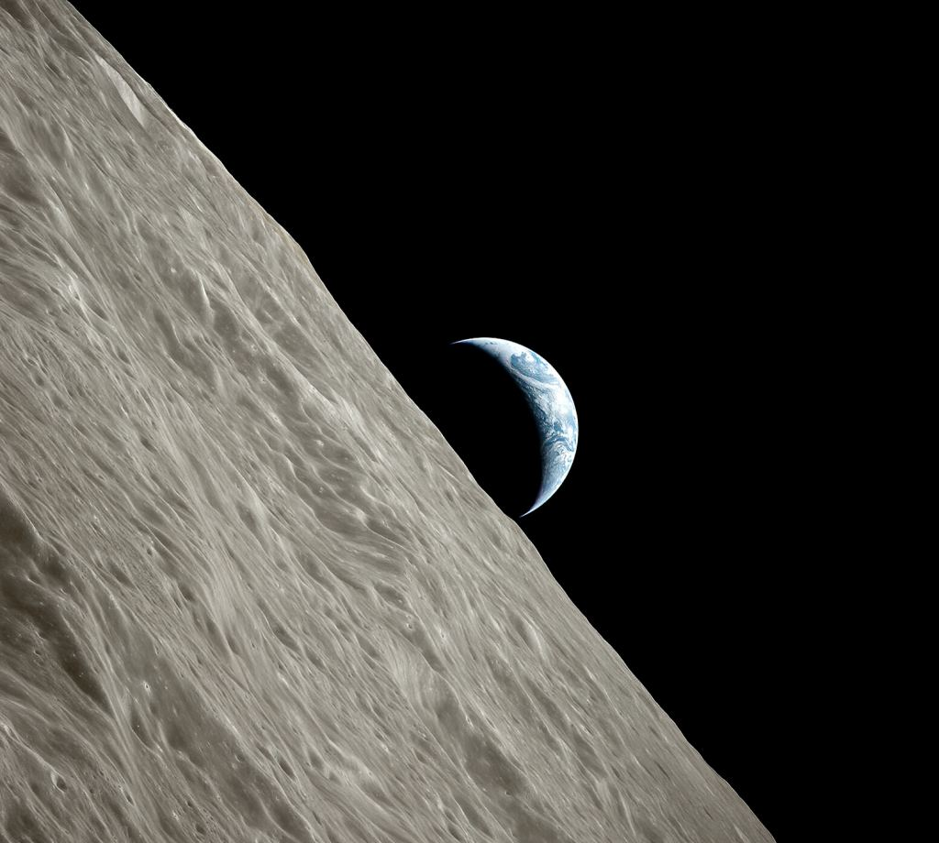
Apollo 17 crew in lunar orbit
takes photo of Earth rising above the lunar horizon
December 1972
NASA’s final lunar mission in the Apollo program.

Slide 4
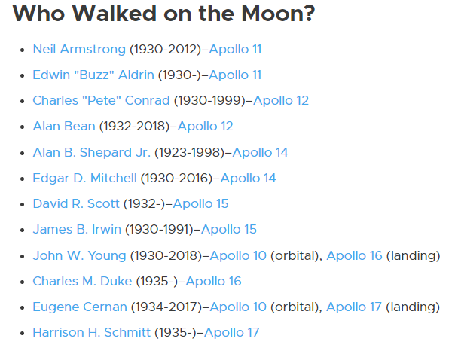
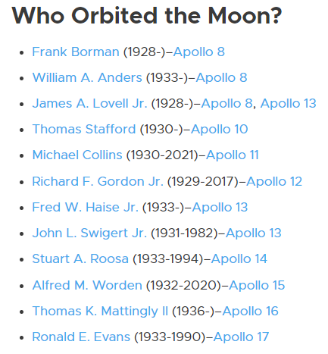
Only 4 Moon Walkers still living

Slide 5
World Population by Age Group
Artemis
Generation
Apollo Generation
84% of the people alive today were born after Apollo 17
About 6 billion people alive today were born after 1972.

Slide 6
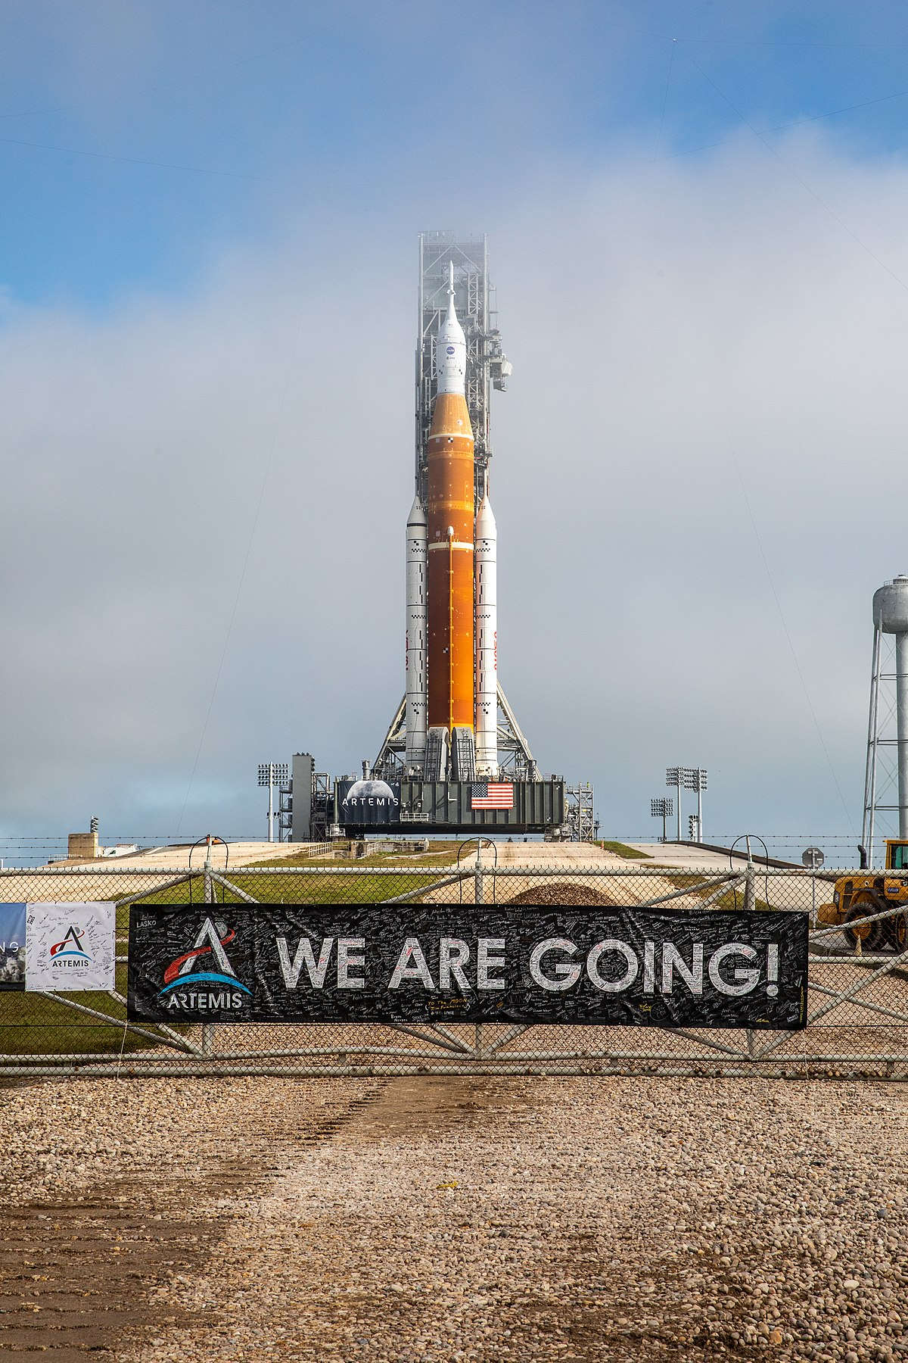
NASA is returning to the Moon
Uncrewed test flight, Artemis 1 will launch in about a month.
Earliest launch date:
Aug. 29, 2022
With backup dates Sept. 2 and Sept. 5
Mission Length ~40 days

Slide 7
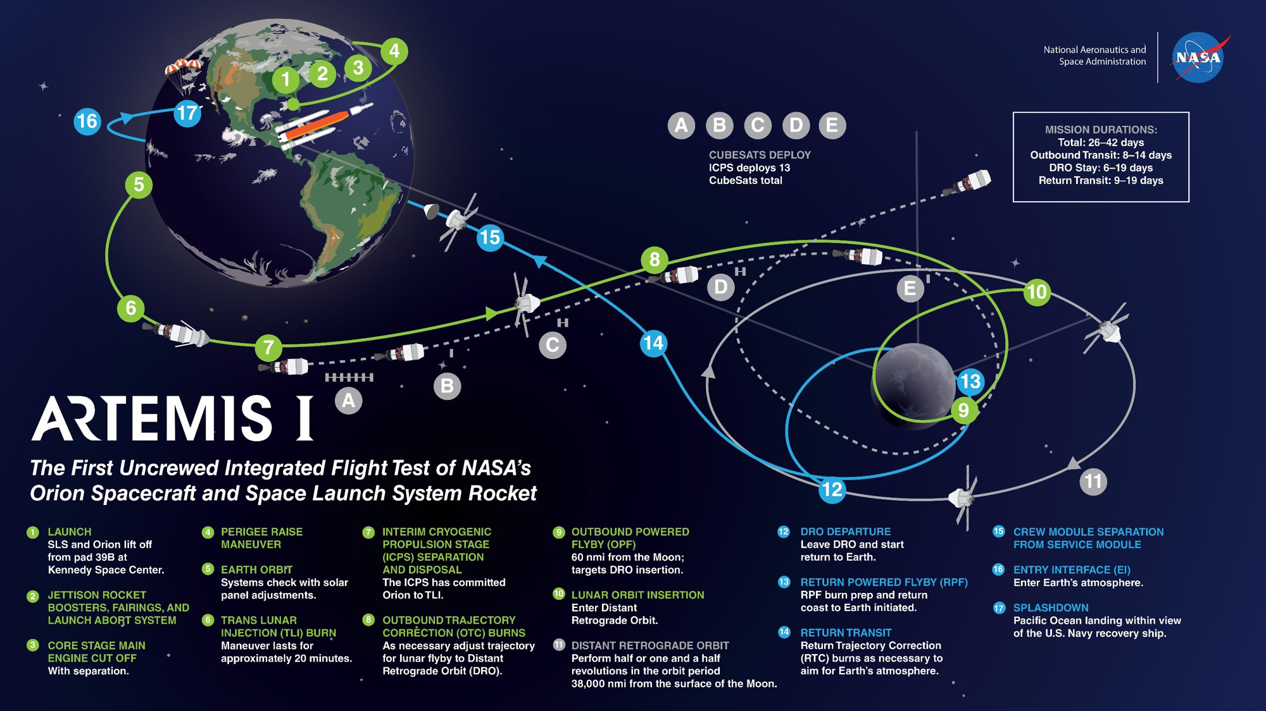

Slide 8
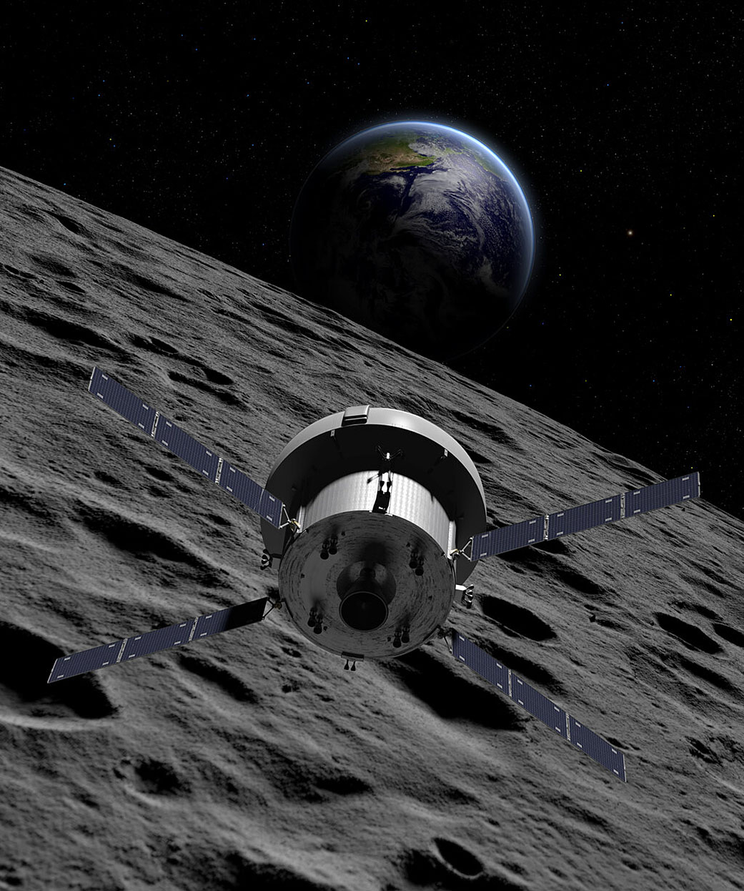
Artemis II will launch in 2024 carrying 4 astronauts around the moon including the first Canadian

Slide 9
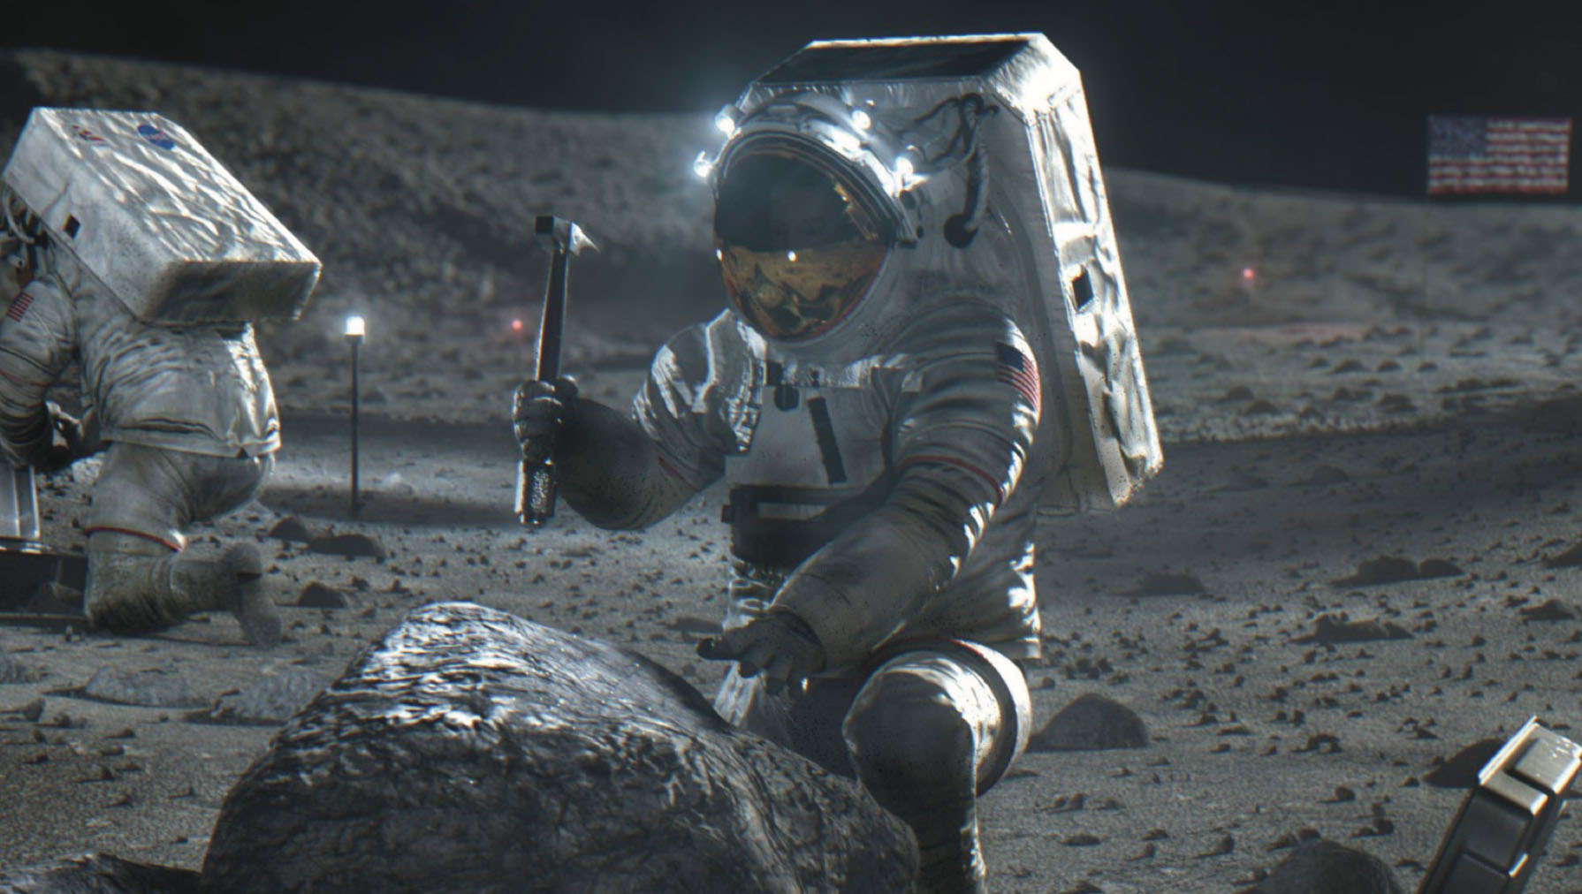
Artemis III
Launching in 2025
With 4 astronauts.
2 will go to the surface.
Including the first woman and the first person of color on the moon.

Slide 10
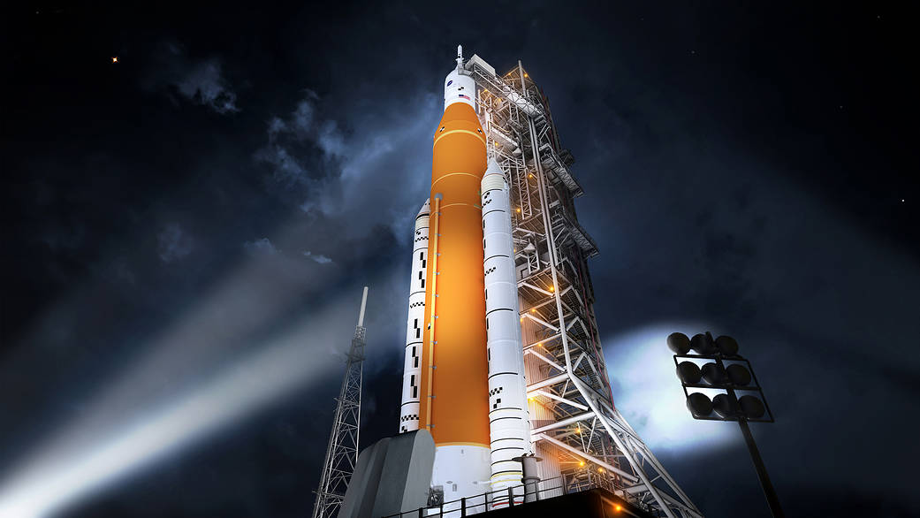
Watch the Launch
August 29, 2022 7:30 AM Central
https://www.nasa.gov/nasalive

